Slide 1
HOMICIDE INCIDENTS VISUALIZATION
Lata Sundaram - 800988539

Slide 2
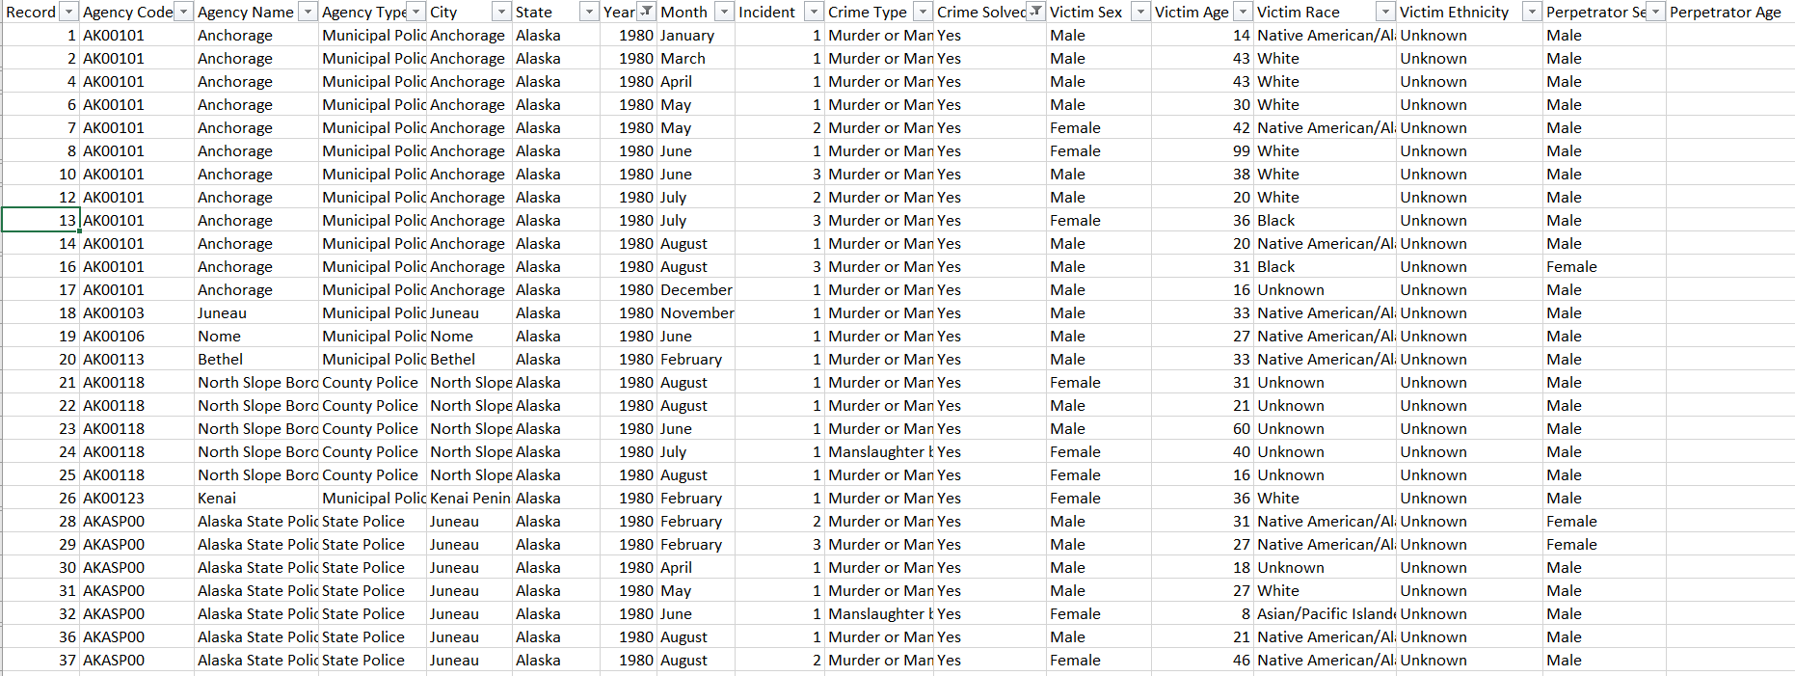
Dataset

Slide 3
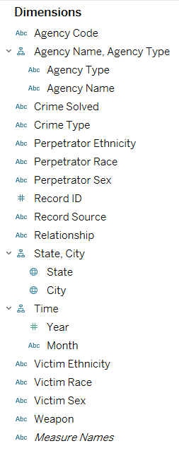
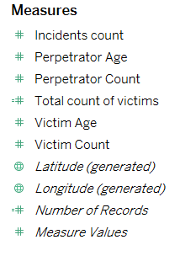
Dimensions and Measures

Slide 4
Tasks
Overall incident rates for states in United States
Analyze the incidents reported based on various states in United States and also display the top 5 cities based on the selected state.
Distribution of number of incidents and Victim Average Age per year along with the forecast for future years.
Data can be filtered based on states, crime type, year and victim sex.
Agency performance dashboard
Analyze the incidents based on crimes resolved or not for each year.
Display the agency types based on the incidents reported.
Display the agency names based on the incidents reported.
Data can be filtered based on agency type, relationship with the victim.

Slide 5
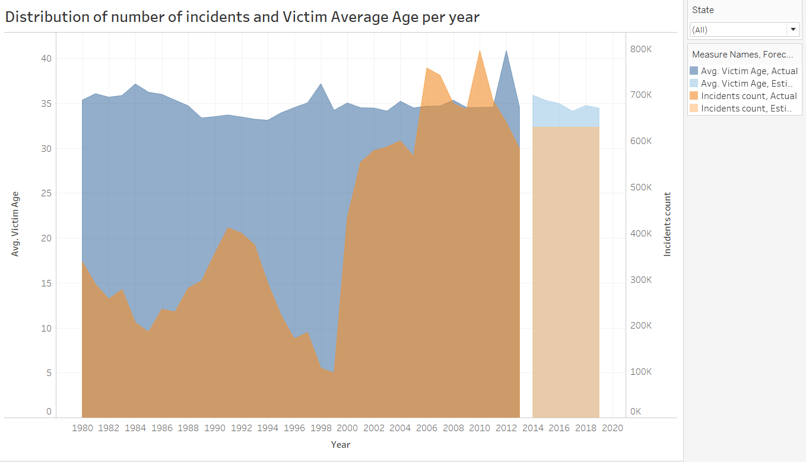
Distribution of number of incidents and Victim Average Age per year

Slide 6
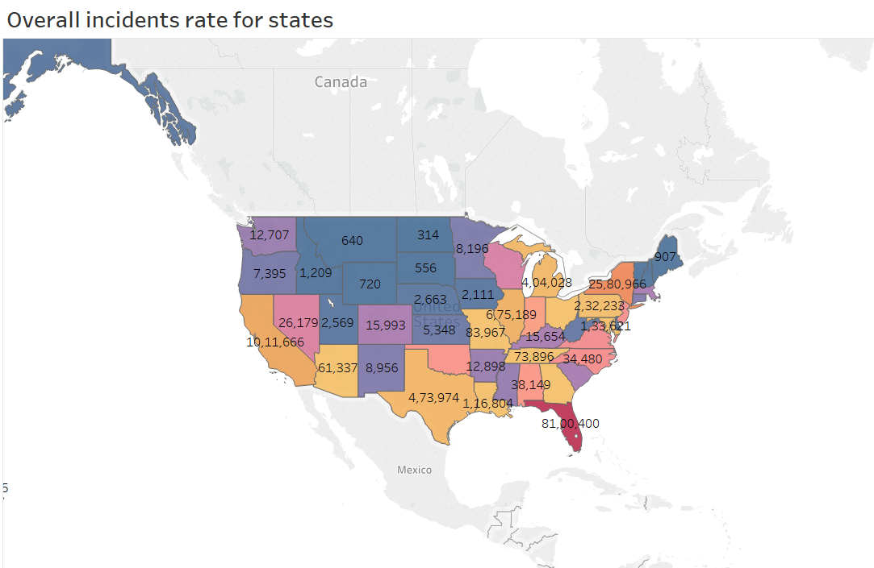
Overall incidents rate for states

Slide 7
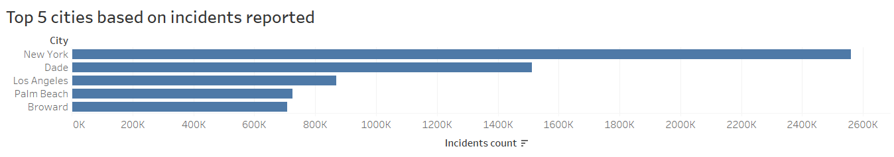
Top 5 cities based on incidents reported

Slide 8
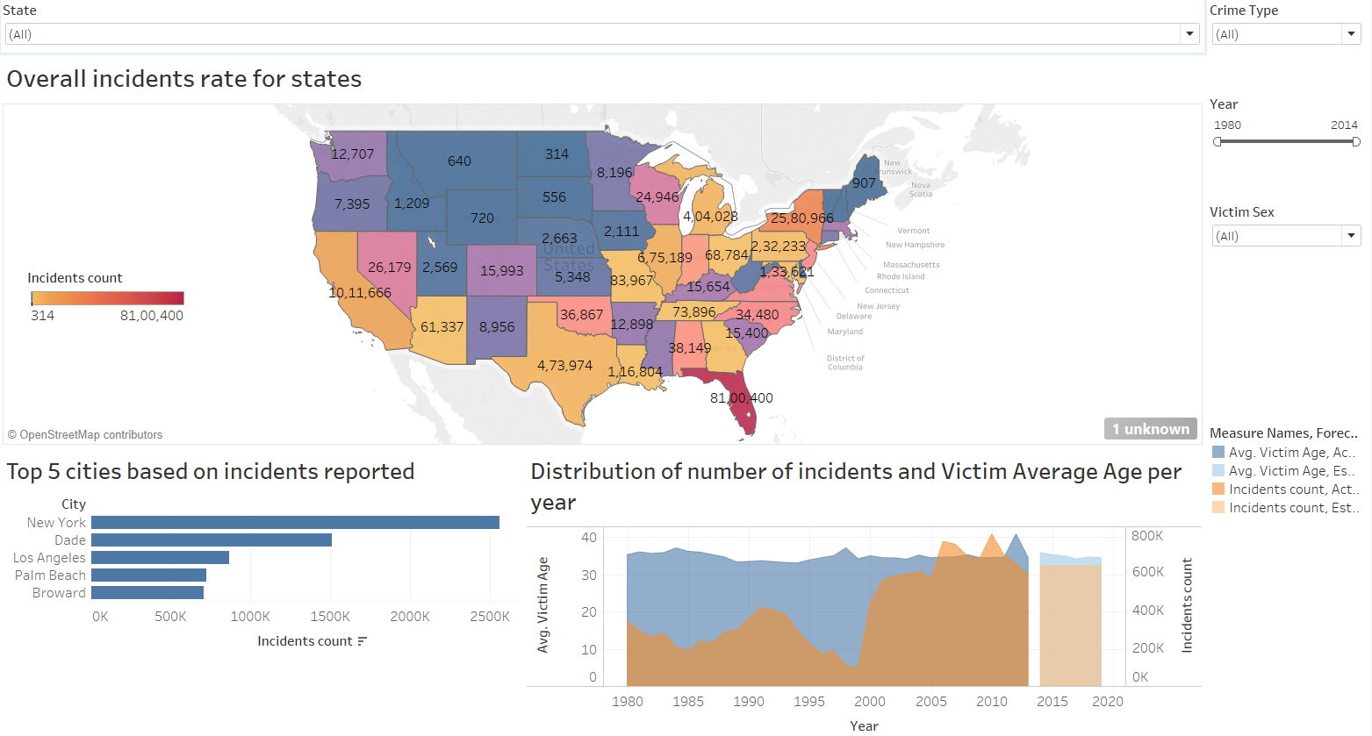
Homicide dashboard

Slide 9
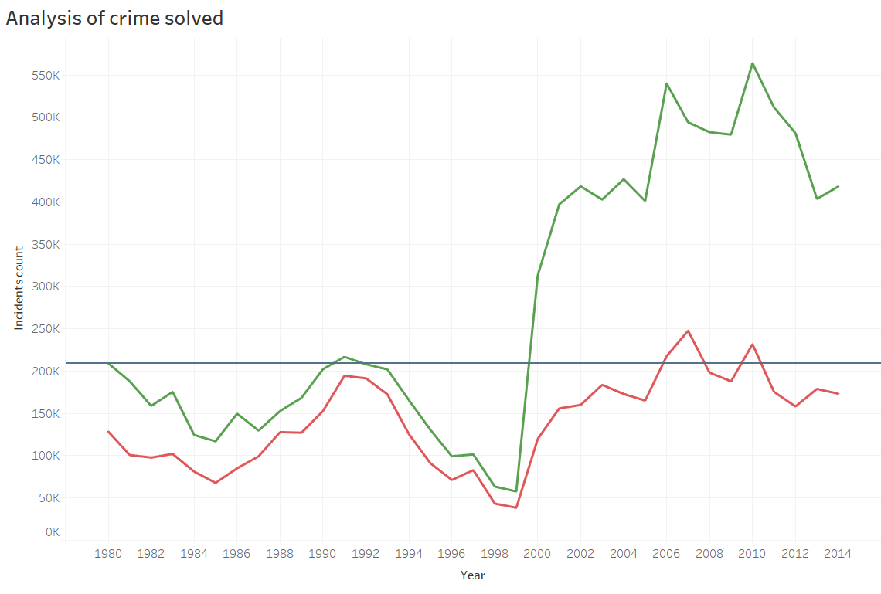
Analysis of crime solved

Slide 10
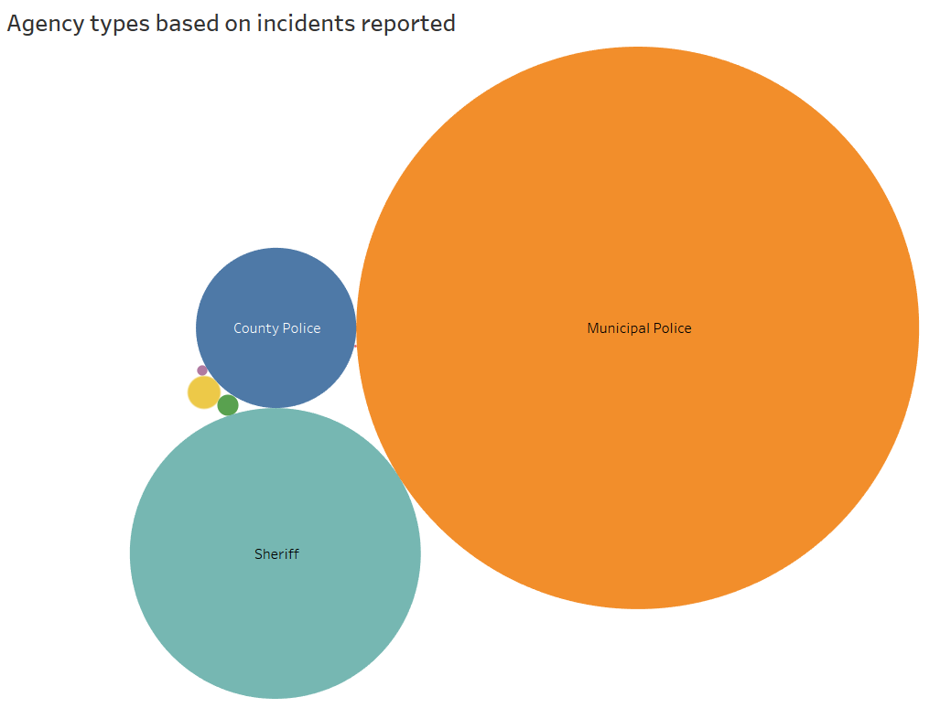
Agency types based on incidents reported

Slide 11
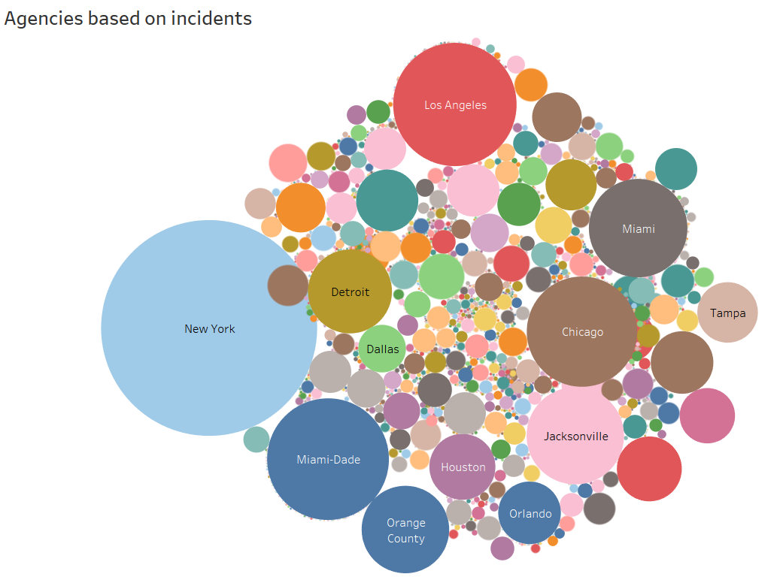
Agencies based on incidents

Slide 12
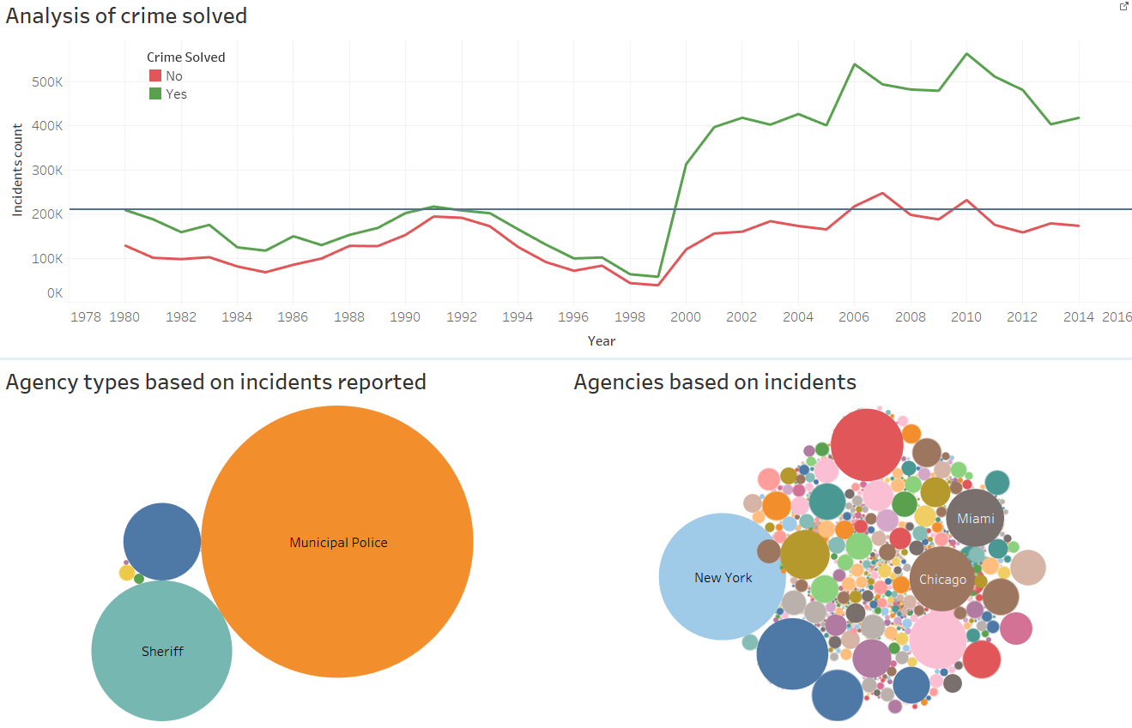
Agency performance dashboard

Slide 13
THANK YOU!

